Slide 1
Resilient and Latency-aware Orchestration of Network Slices Using Multi-connectivity in MEC Enabled 5G Networks

Slide 2
Abstract
Design of resilient network architecture is required for providing continuous services in certain situations. Time-critical services need to work in un-interrupted environment even in the case of multiple component failures. Thus a resilient network architecture is required to handle failure of multiple network components. Binary Integer Programming (BIP) is used to optimally deploy network slices with the minimum cost.
An efficient genetic algorithm based heuristic is used to obtain near-optimal solution in polynomial time. This reduces resource wastage, and also improves throughput while providing high resiliency against failures.

Slide 3
Introduction
Network operators leverage NFVI and SDN at MEC cloud facilities for instantiating a set of VNFs to deploy NSs and offer services in a dynamic manner as per the demand. NS and MEC reduce expenditures (both CAPEX and OPEX) by sharing the physical infrastructures and handling the service traffic locally at the network edge, respectively.
Inspite of the above there are certain challenges in terms of availability and guaranteeing service continuity. Both software (e.g., VNFs and virtual links) and hardware (e.g., MEC cloud servers and physical links) network components are subject to failure and a single component failure (either software or hardware) will result in interruption of service and service unavailability.

Slide 4
Softwarization technologies (VNFs, MEC) are more prone to failures and communication links may fail due to software bugs, misconfiguration, overloading, hardware faults, cyber attacks and power outage. Thus providing reliable communication services are very important.
To handle failure of different network components, dedicated backups can be assigned jointly along with primary entities.

Slide 5
Several issues should be taken into account before deploying NSs and assigning backups:
operational and maintenance cost of MEC cloud facility where NSs are deployed
deployment cost of NSs by activating MEC cloud servers
forwarding cost of service traffic from base station to MEC cloud facility.
One approach can be:-
Placing both primary and backup NSs in a single MEC cloud server can reduce the cost.
Second approach:-
placing primary and backup NSs in different MEC cloud servers.

Slide 6
Third Approach:-
multiple backups can be placed on the MEC cloud facility.
To minimize the overall cost, multiple NSs can be placed on a single MEC cloud facility based on the resource availability, but some requests may not meet the end-to-end latency requirement depending on the users’ location.

Slide 7
MC and MEC enabled 5G network architecture
MC is an extension of Dual Connectivity .
DC allows User Equipment (UE) to simultaneously connect with multiple BSs that belong to the same Radio Access Technology (RAT).
MC allows UE to simultaneously connect with multiple BSs even if they belong to different RATs.
In this work, we assume that the user is attached with two BSs and inter-frequency connection is considered. One base station acts as a master node and the other as a secondary node.
Primary and backup NSs are deployed in different MECs which are connected to the user through master and secondary BSs, respectively.
Resources at MECs are managed by VIM and NSs are managed by NFVO/MECO.
MC helps to improve performance in terms of throughput and reliability.

Slide 8
Major Contributions
MEC is used to support ultra-low latency service demands.
Different possible failures in MEC enabled 5G networks is discussed, and show different dedicated backup methods to handle failures.
Problem is formulated as a BIP model and it is implemented using CPLEX to obtain optimal solution for small scale network. It is proved that the problem is NP-hard using a reduction technique.
Owing to high time complexity of the BIP model for obtaining the optimal solution in large scale network, we propose genetic algorithm based heuristic approach to obtain near-optimal solution in polynomial time.
A real-world network topology is used for evaluating the performance quality of the proposed heuristic solution.

Slide 9
Related work
VNF placement and resource allocation problem is considered in NFV/SDN enabled MEC networks with the goal of minimizing the overall placement, resource cost and minimizing end-to-end latency.
Neural-network based model is used to proactively predict the number of VNFs required to process the network traffic.
Also there are studies related with dynamic latency optimal VNF placement problem with the goal of minimizing the end-to-end latency.
However, in the above mentioned works failure of network components and resiliency aspects are not considered, and only a single VNF placement is considered for slice creation.

Slide 10
In resilient NS embedding problem is considered in 5G networks with the goal of minimizing the impact due to failure of network components. However, the proposed protection strategies in and are not resilient to multiple failures, designed to handle a single node failure and the assigned backup resources are idle and the resource utilization is less. In this work, we propose a resilient and latency-aware NS deployment strategy in MC and MEC enabled 5G networks to provide high resiliency against multiple network component failures, improve resource utilization, and meet the service requirements (e.g., latency) of the users.

Slide 11
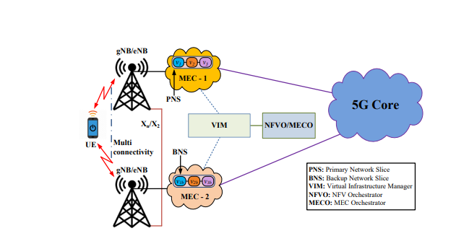
Multi-connectivity and MEC enabled 5G network architecture.

Slide 12
Network Model
The Physical Network is modelled as an undirected graph G_{p} = (N ,L).
N= set of BSs/access points.
L = Set of physical links that interconnect the BS’s.
The BSs can be interconnected by SDN based backhaul network through X2 or Xn interface.
A small subset of BSs are chosen to establish MEC cloud facilities.
set of locations where MEC cloud facilities are being established = F, where F ⊂ N.
a set of limited number of servers available at F to provide services for user requests = P

Slide 13
Available resource capacity (e.g., CPU, RAM, and storage space) at each server p ∈ P = Cs
MEC cloud facilities are connected with VIM and VIM is responsible for managing NFVI with SDN controller.
VIM is connected with NFVO/MECO which orchestrates services and manages the life cycle of NSs through VIM.

Slide 14
The Virtual Network is modelled as undirected graph G_{v} = (V, E).
set of all possible VNFs which can be used to construct NSs in NFV-enabled MEC cloud facility = V
set of virtual links used to interlink VNFs of NS = ε
NS consists of a set of VNFs which can be instantiated on top of the MEC cloud servers in order to provide service for the specific request.
For each VNF type v ∈ V, amount of resource to process the incoming traffic = C_{v}

Slide 15
Working of the network model
Multiple users are connected to the network through near by BSs.
Users are attached with two BSs (eNB/gNB) simultaneously using multi-connectivity strategy in 5G networks.
set of service requests as S
each user service request s ∈ S is denoted as (V_{s}, n¹_{s}, n²_{s} , b_{s}, d_{s})
set of VNFs required to construct a particular NS = V_{s} ∈ V
n¹_{s} ∈ N denotes the master or primary base station in which a user is attached to and requests for a service s
n²_{s} ∈ N denotes the secondary or backup base station in which the user is attached to and requests for the service s

Slide 16
bandwidth requirement for the service type s = b_{s}
maximum allowed end-to-end latency for the service type s = d_{s}

Slide 17
Problem statement
Both software and hardware failures of network components is considered here in order to design a highly resilient system.
Failure of a VNF will disrupt a service which is depending on it.
Failure of a single MEC cloud server or a communication link will affect the operations of multiple VNFs that are sharing the same resource.
In the worst case, an entire MEC cloud facility with multiple MEC cloud servers may fail due to various factors.
We assume that network components/functions fail independently of the other components/functions in the network

Slide 18
Backup methods to handle failure of network components in MEC-enabled networks.
Method 1:-
backup to the primary NS is assigned in the same server.
Method 2:-
backup to the primary NS is assigned in different server in MEC. Backup method 1 can handle only VNF failure, whereas backup method 2 can handle VNF failure and a single MEC cloud server failure
Method 3:-
backup to the primary NS is assigned in different MEC cloud facility. It can handle multiple servers failure in MEC-1. Backup method can handle both physical link and server failures as primary and backup NSs are located in different MEC cloud facilities.

Slide 19
Example
6 base station nodes and a few MEC cloud facilities are activated to provide services to the users.
Users attach to the network through nearby BSs and then NSs (primary and backup) deployed to provide services with high resiliency.
To handle failures effectively, primary and backup NSs are deployed in different MECs.
We consider that three MECs (MEC-1, MEC-2, and MEC3) are already activated to provide services for users and they have enough resources to accommodate future requests.
A UE-i is attached to the network through single connectivity.
We assume that the latency requirement from UE-i is 2 ms and communication delay from the user location to BSs through wireless medium is in the order of microseconds.
Since MEC-3 is already activated, primary NS for UE-i is deployed in MEC-3 without violating latency requirement. However, backup NS cannot be placed in the existing other activated MECs (MEC-1 and MEC-2), because latency requirement is violated (requirement is 2ms, but UE-i takes 3 ms to reach MEC-1 and 4 ms to reach MEC-2).
Therefore, the orchestrator activates a new MEC (MEC-4) at the base station 6 in order to meet the latency requirement. Even though the other existing MECs (MEC-1 and MEC-2) have enough resources to accommodate backup NS for UEi, the orchestrator is forced to activate the new MEC (MEC-4) to provide service.

Slide 20
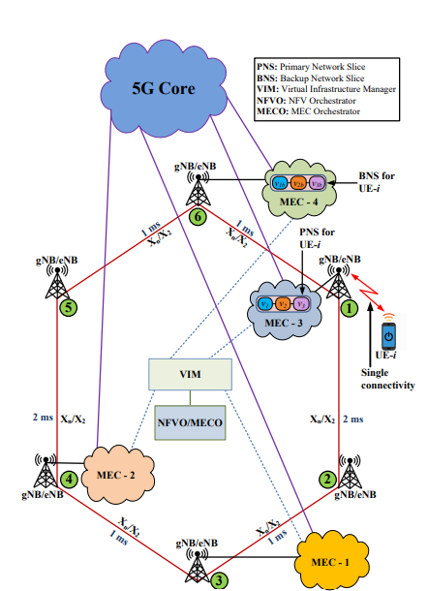
User association with MEC-enabled 5G network through single connectivity

Slide 21
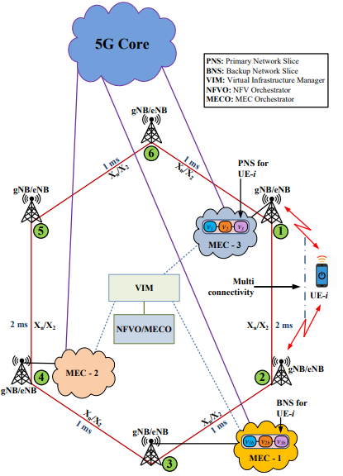
User association with MEC-enabled 5G network through multi-connectivity

Slide 22
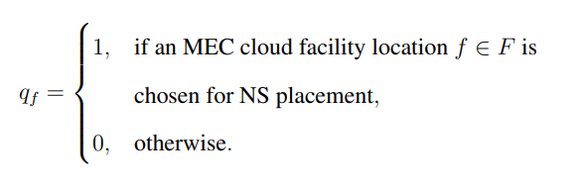
BIP Formulation
Input = Network characteristics and NS requirements are given to BIP. Output = optimal creation of NSs that minimizes the overall service cost.
Decision variable:- We define the binary decision variable q_{f} to represent the selection of MEC cloud facility for provisioning services, which can be expressed as:

Slide 23
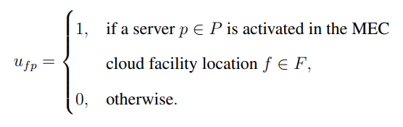
We define the binary decision variable u_{fp} to represent a server in the MEC cloud facility location is activated for creation of NS, which can be expressed as:

Slide 24

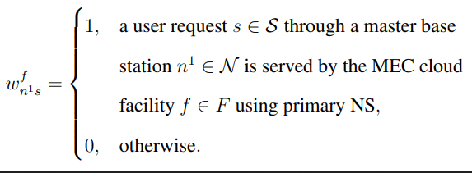
We define the binary decision variable to represent a request through a master base station node is served by the MEC cloud facility using primary NS, which can be expressed as:

Slide 25

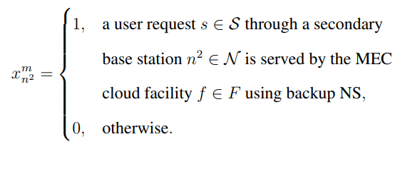
We define the binary decision variable to represent a request through a secondary base station node is served by the MEC cloud facility using backup NS, which can be expressed as:

Slide 26

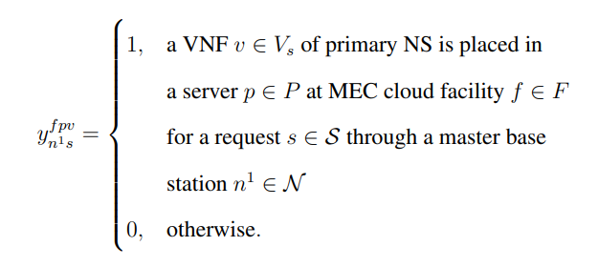
We define the binary decision variable to represent that a VNF of primary NS of request is placed in the server at MEC cloud facility, which can be represented as:

Slide 27

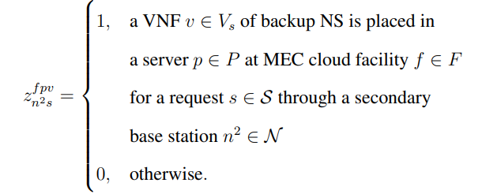
We define the binary decision variable to represent that a VNF of backup NS of request is placed in the server at MEC cloud facility, which can be represented as

Slide 28
Objective Function
Here the goal is:
To minimize the cumulative costs of number of MEC cloud facilities used
Number of physical MEC cloud servers activated for deploying NSs
Amount of service traffic being forwarded on each link for provisioning resilient and latency-aware communication services.

Slide 29
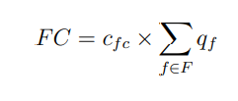
MEC Cloud Facility Cost: It includes operational and maintenance costs of MEC cloud facility which can be expressed as:
where c_{fc} denotes operational and maintenance cost
for a single MEC cloud facility.

Slide 30
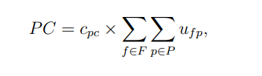
MEC Cloud Server Activation Cost: It includes design, procurement, and deployment of NSs to provide resilient and latency-aware communication services which can be expressed as:
where c_{pc} denotes the cost for a single server in MEC cloud facility.

Slide 31
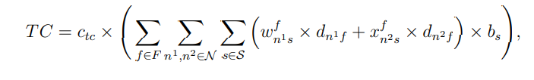

Forwarding Cost of Service Traffic: It is the cost for forwarding service traffic over the communication link, which can be expressed as:
where c_{tc} denotes traffic forwarding cost for the service request s and it is calculated per Mbps, denotes the actual delay from the master (secondary) base station to MEC cloud facility, and b_{s} denotes bandwidth requirement of the service request.

Slide 32
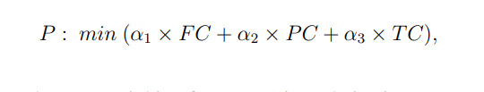
The objective is to minimize the overall cost of the aforementioned costs, which can be expressed as follows:
where α₁, α₂, and α₃ are weighing factors to give relative importance to the objective functions.

Slide 33
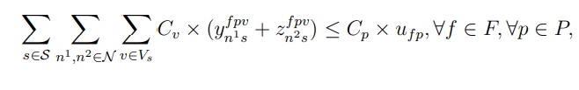
Constraints
The total resource requirement of VNFs of NSs should not exceed the available resource capacity of the MEC cloud server which hosts them, which can be expressed as:
where C_{v} denotes resource requirement of VNF of NS and C_{p} denotes the available resource capacity of the MEC cloud server.

Slide 34
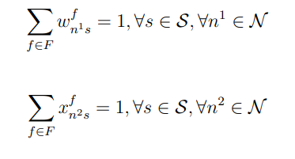
A user request through the master base station or secondary base station is served by only one of the MEC cloud facilities (i.e., the entire slice is constructed in a single MEC cloud facility in order to meet the latency constraint), which can be expressed as:

Slide 35

In a single MEC cloud facility, either a primary NS or backup NS of a request is deployed and not both (i.e., master base station and secondary base station are attached to different MEC cloud facilities). It is mathematically expressed as:

Slide 36
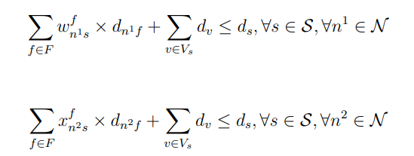
The actual end-to-end delay (including propagation delay and processing delay) for NSs (primary or backup) should be less than or equal to the maximum allowed delay requirements of the users, which can be expressed as:
Where d_{v} denotes the processing delay of the VNF of an NS.

Slide 37
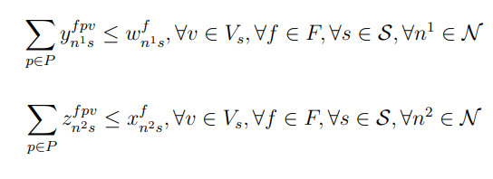
The required VNFs for constructing NS (both primary and backup) for the user request through the base station (both master and secondary) is mapped to servers in the MEC cloud facility, which can be expressed as:

Slide 38
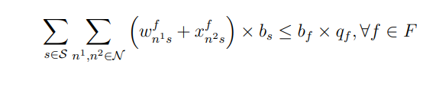
The total bandwidth requirement of service requests should not exceed the available bandwidth at the MEC cloud facility:
where b_{f} denotes the available bandwidth to the MEC cloud facility location from the associated base station.

Slide 39
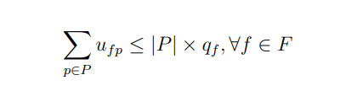
The MEC cloud facility location is chosen if at least one of the servers in it is used for NS deployment to provide service, which can be expressed as:
where |P| denotes the total number of servers in an MEC f.

Slide 40
Resilient and latency-aware orchestration of NSs in MEC is an NP-hard problem.
RCFL problem : the problem is to select facilities from the given set of potential facility locations, where each facility has limited capacity and subject to failure. To prove that the problem A is NP-hard, it is sufficient to show that an instance of the problem B can be reduced to an instance of the problem A in polynomial time, i.e., B.

Slide 41
We can transform an instance of the problem B into an instance of the problem A in the following way:
i) consider each facility in the problem B as equivalent to an MEC cloud facility in the problem A
ii) set the capacity of the facility in the problem B to be equal to the capacity of the MEC cloud facility in the problem A
iii) set the cost of activating facility in the problem B is equivalent to operational cost of MECs and the activation cost of servers to deploy NSs in the problem A
iv) set the transportation cost in the problem B as the traffic forwarding cost in the problem A. The transformation operation can be done in polynomial time of the input size.

Slide 42
Proposed Heuristic Solution
We propose a genetic algorithm (GA) based metaheuristic solution to overcome the scalability issue of the BIP problem.
GA operates iteratively for a fixed number of generations and only the fittest individuals are passed to the next generation.
At each generation/iteration a fixed P number of individuals/solutions are considered and the following four operations are performed to produce better individuals for the next generation: i) selection, ii) crossover, iii) mutation, and iv) elitism.

Slide 43
Operations
Initial population: Usually, a set of S random individuals (also known as candidate solutions) are taken as initial population. In this work, we first sort the service requests based on the latency requirement (from lower to higher) and then the required VNFs of NSs are randomly placed in the MEC cloud servers with the condition that service requirements are met.
Encoding: In GA, each individual or candidate solution in the population is encoded as chromosome which consists of a number of genes with a specific property. In this work, each candidate solution (i.e., a chromosome) represents a particular placement of the required set of VNFs of NSs onto MEC cloud servers (i.e., genes) to provide services without violating the requirements of users.

Slide 44
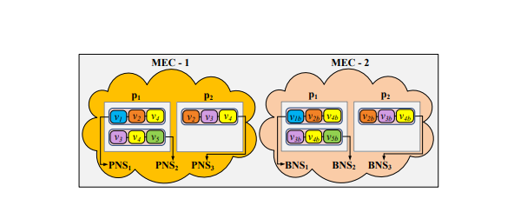
Chromosome representation

Slide 45
Evaluation and selection: Each individual is evaluated by a fitness function. The fitness function is the objective function defined in the BIP formulation. Our objective is to minimize the overall service provisioning cost while supporting high resiliency and end-to-end latency requirements of users. Selection mechanism selects better individuals as parents for crossover and mutation in order to produce much better new individuals/candidate solutions. In this work, we use rank based selection method to choose individuals for performing genetic operations.

Slide 46
Crossover/Recombination: Crossover is a convergence genetic operator used to produce new individuals (also called as offspring) by exchanging genetic properties of two parents. In this work, two parents/individuals (chromosomes) are selected based on rank selection method for performing crossover operation using rank based selection. MEC location of NSs of parent 1 and parent 2 are swapped if service requirements are met after swapping.
Mutation: Mutation operation helps to come out of the local optimal solution and get better solution in the evolution process of each generation. In this work, either primary NSs or backup NSs of the candidate solution are moved to a new MEC randomly.

Slide 47
Elitism: Elitism allows to copy the fittest parent individuals to the next generation without modifying their genes or genetic structure. At each generation, additionally, I new individuals (children) are generated from the original I individuals (parents) based on crossover and mutation operations. Thus, total there will be 2 × I individuals (parents + children) at the end of each generation. These 2 × I individuals are evaluated using fitness function in order to assess their suitability for being selected as parents for the next generation.

Slide 48
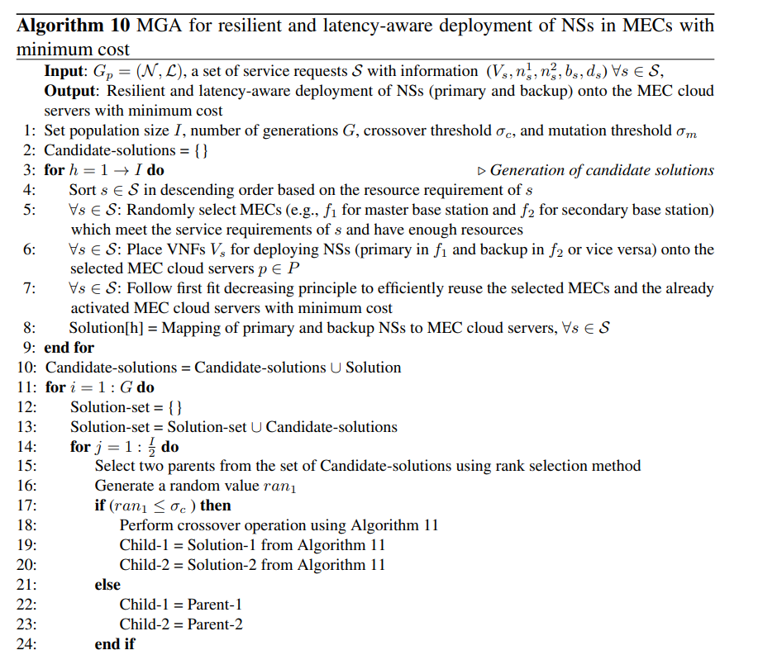
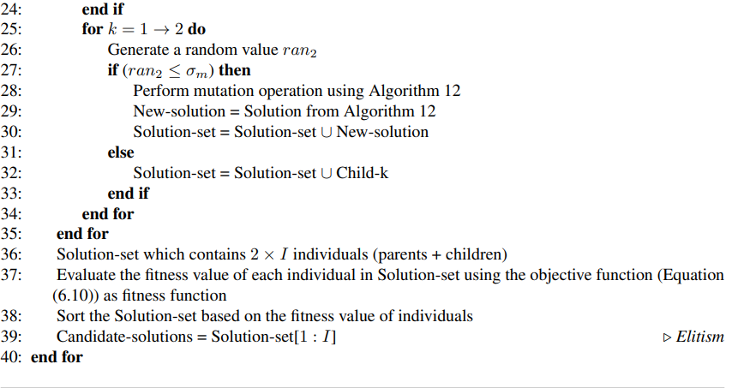
Algorithms

Slide 49
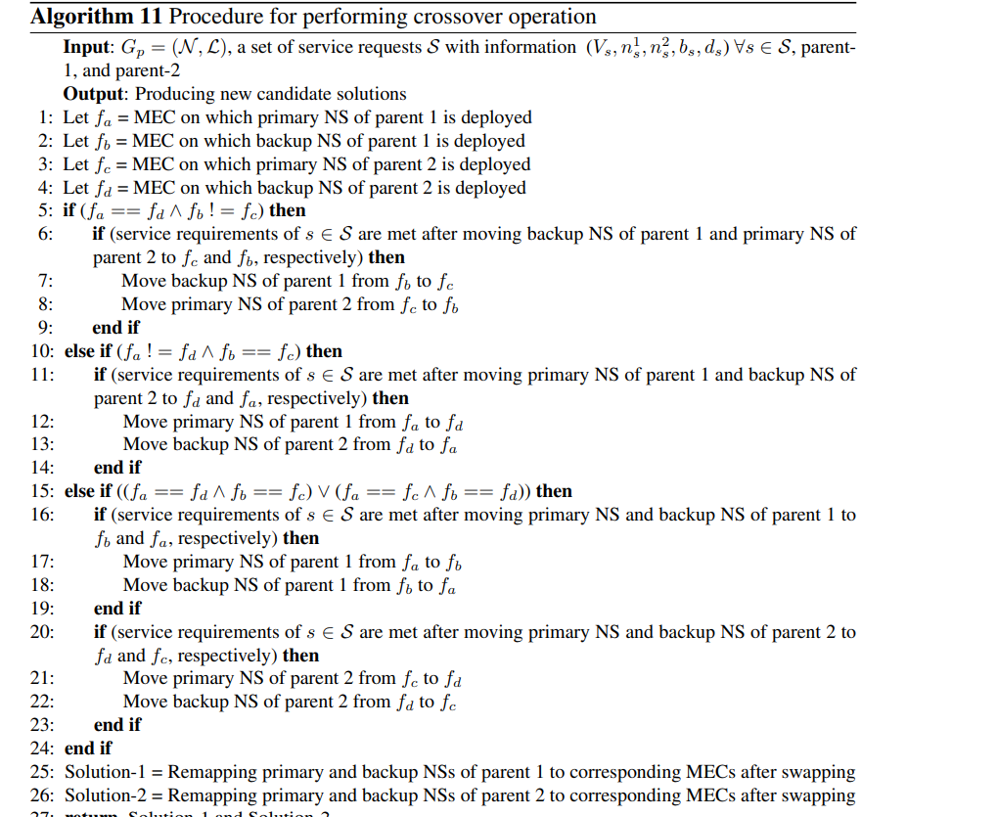

Slide 50
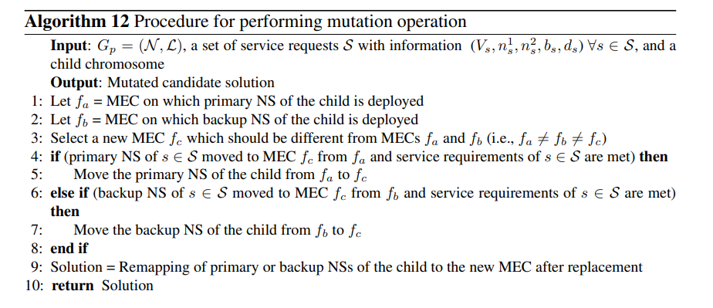

Slide 51
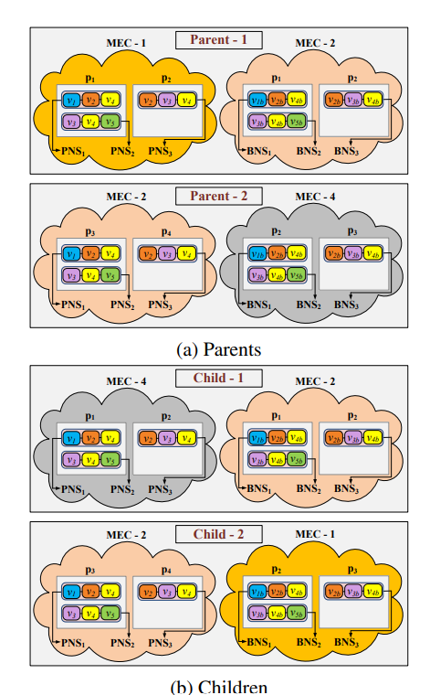
Example of crossover

Slide 52
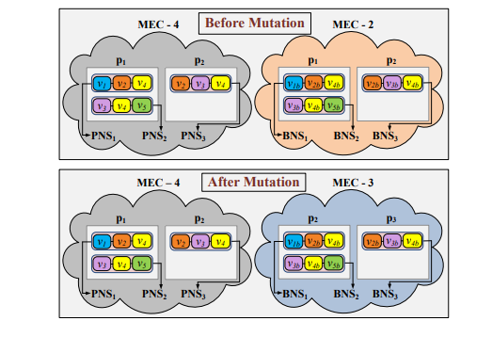
Example of mutation

